Slide 1
FACTORS INFLUENCING RESIDENTIAL HOME PRICES IN THE UNITED STATES
A MECE APPROACH
Exploring the Key Factors and Their Impact on
US Residential Home Prices

Slide 2
OBJECTIVES
Explore factors influencing the US residential housing market.
Analyze correlations between key factors and residential housing prices.
Develop a Mutually Exclusive, Collectively Exhaustive (MECE) framework for understanding the factors that could impact the US residential home prices in the future.
Provide insights into the dynamics driving the US housing market.

Slide 3
TABLE OF CONTENTS
01
02
03
INTRODUCTION
POTENTIAL FACTORS
CORRELATIONS
04
05
06
MECE FRAMEWORK
CONCLUSION
ACKNOWLEDGEMENTS
A brief explanation of MECE framework
Widely recognized drivers of housing market dynamics
Correlation analysis of identified factors and housing sales price
MECE framework for factors influencing the US housing market
Key findings and insights from the analysis
Reference to articles, data sources and other resources utilized during the research

Slide 4
INTRODUCTION
MECE is a problem-solving framework used for organizing and structuring information in a way that ensures comprehensive coverage and avoids duplication or overlap.
Mutually Exclusive :
“Are there any instances of overlapping or duplication?”
Collectively Exhaustive:
“Have I considered all possible scenarios?”
MECE
Mutually Exclusive Collectively Exhaustive

Slide 5
POTENTIAL FACTORS
An article published by Investopedia explains how key factors mentioned below drive the Real Estate Market.
INTEREST RATES
As interest rates rise, the cost of a mortgage increases, thus lowering demand and real estate prices.
DEMOGRAPHICS
Data that reflect the composition of a population such as age, race, gender and population growth.
THE ECONOMY
Measured by indicators such as GDP, employment data, manufacturing activity etc.
GOVERNMENT POLICIES and SUBSIDIES
Tax credits, deductions, and subsidies are some of the ways the government can temporarily boost demand for real estate.

Slide 6
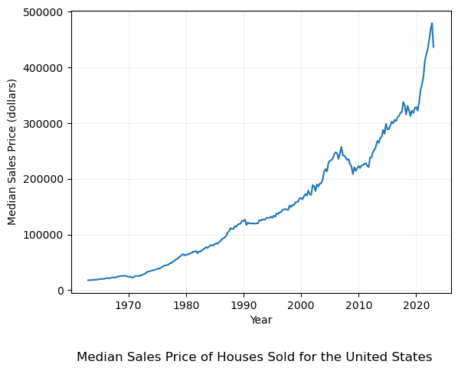
Median Sales Price of homes sold in the United States
2023
$436,800
2009
$208,400
2005
$232,500
1995
$130,000
1963
$17,800

Slide 7
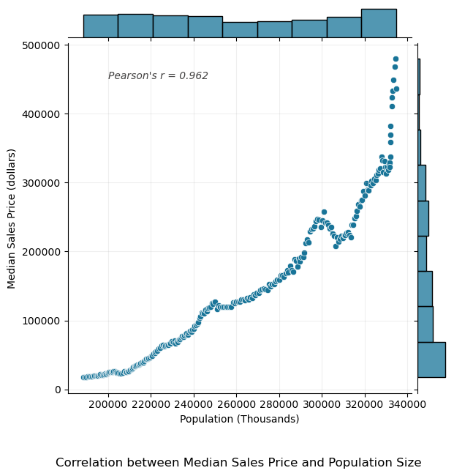
CORRELATIONS – Demographics (Population Size)
Very strong positive correlation between Population Size and Median Sales Price of houses sold in the United States.
Correlation doesn’t imply causation, however with the increase in population size, it is fairly reasonable to think that more people need shelter which could significantly drive the demand for residential homes. This demand could result in increased Sales Price.
Similarly, age distribution, another demographic variable could have a role in shaping the real estate market since different age groups have varying housing needs and preferences.
Refer Jupyter Notebook for data and code used to generate the scatter plot.

Slide 8
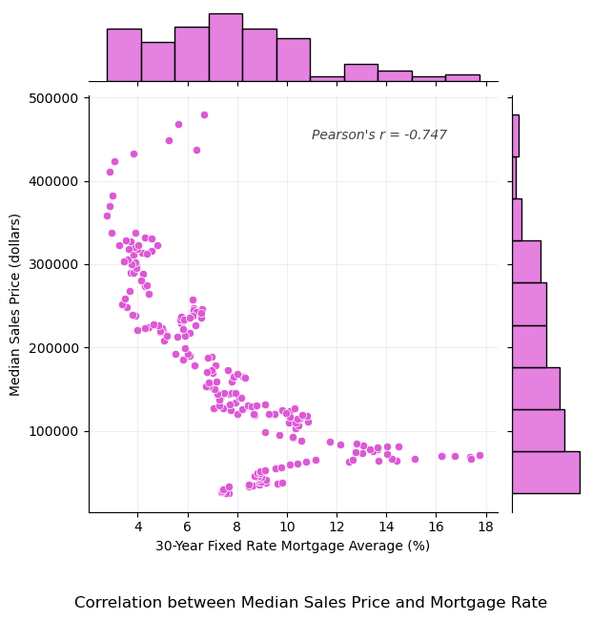
CORRELATIONS – Interest Rates (Mortgage Rate)
Strong negative correlation between Mortgage Rate and Median Sales Price of houses sold in the United States.
Again, while correlation doesn’t imply causation, changes in interest rates can greatly influence a person’s ability to purchase a residential property. That’s because the lower the interest rate, the lower the cost of the mortgage.
The scatter plot suggests that as interest rates rise, the cost of a mortgage increases, thus lowering demand and real estate prices, which supports the explanation in Investopedia’s article.
Refer Jupyter Notebook for data and code used to generate the scatter plot.

Slide 9
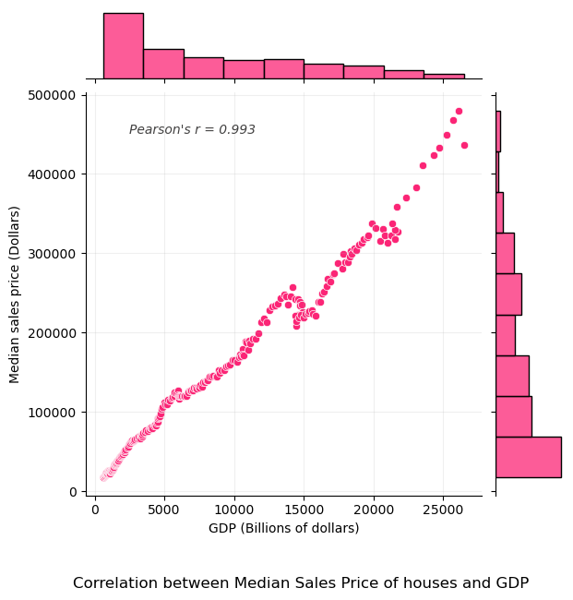
CORRELATIONS – The Economy (Gross Domestic Product)
Very strong positive correlation between GDP and Median Sales Price of houses in the United States.
When the GDP of a country is increasing, it usually signifies a growing economy, higher employment rates, and increased consumer confidence. This could suggest a hypothesis that there is higher demand for housing as people feel more financially secure and are more willing to make a real estate investment.
Economic growth is often accompanied by infrastructure development and urbanization. This could enhance the desirability and value of residential properties in certain areas, thereby influencing Sales Price.
Refer Jupyter Notebook for data and code used to generate the scatter plot.

Slide 10
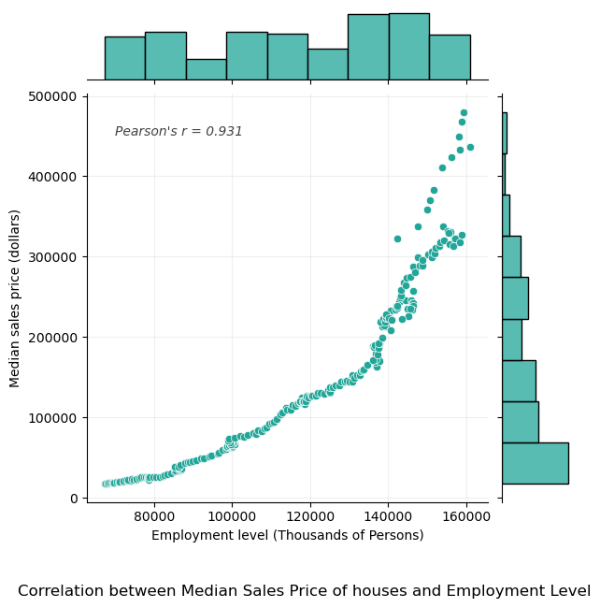
CORRELATIONS – The Economy (Employment Level)
Strong positive correlation between Employment level and Median Sales Price of houses in the United States.
The employment level directly affects the income and financial stability of individuals and households.
When employment levels are high and people have steady income, they are more likely to afford and purchase homes. Increased employment opportunities can lead to higher demand for housing, which in turn can drive up prices.
Refer Jupyter Notebook for data and code used to generate the scatter plot.

Slide 11
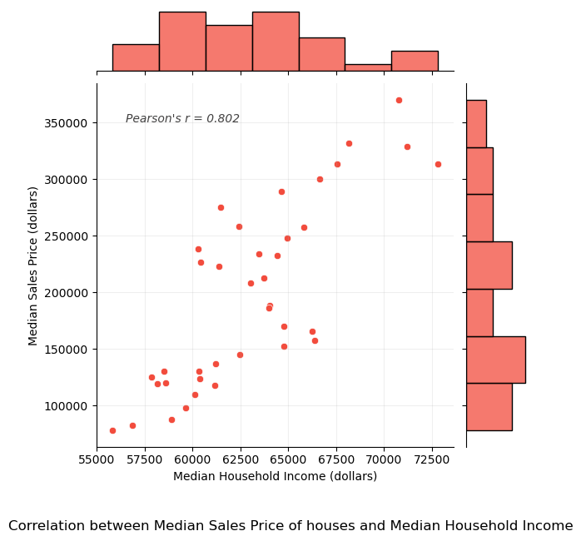
CORRELATIONS – The Economy (Employment Level)
Strong positive correlation between Median Household Income and Median Sales Price of houses in the United States.
Median household income is a key indicator of the financial capacity of individuals and households to afford housing.
Higher median household incomes generally indicate higher purchasing power and the ability to afford more expensive homes. As median household income increases, it can lead to increased demand for housing in higher price ranges, which can contribute to upward pressure on housing prices.
Refer Jupyter Notebook for data and code used to generate the scatter plot.

Slide 12
Government Policies and Subsidies
As explained in the Investopedia’s article, legislation is another factor that can have a sizable impact on property demand and prices.
Tax credits, deductions and subsidies are some of the ways the government can temporarily boost demand for real estate.
Governments may offer mortgage programs, such as low-interest loans or down payment assistance, to facilitate homeownership. By making it easier for individuals and families to access financing, these programs can increase homeownership rates and drive up housing demand, potentially leading to higher prices.

Slide 13
Mutually Exclusive Collectively Exhaustive (MECE) framework
DEMOGRAPHICS
Population growth, age, race, gender, migration patterns etc.
INTEREST RATES
Exhibits inverse relationship with residential property prices.
THE ECONOMY
When economy is sluggish, so is the real estate market.
GOVT POLICIES AND SUBSIDIES
Government can temporarily boost demand for real estate.
UNIDENTIFIED FACTORS
Additional factors that are currently unknown or difficult to predict.

Slide 14
CONCLUSION
Recapping the Objective
Key Findings
MECE Framework
This analysis aimed to explore the factors influencing residential home prices in the US and strengthen the MECE framework to better understand the dynamics of the housing market.
Through statistical analysis and examination of correlations, economic factors like GDP, employment levels and household incomes, demographic factors like population size, and factors like interest rates particularly mortgage rates showed strong correlations with housing prices in the US. These observations align with the factors mentioned in an article published by Investopedia.
Identified factors were then organized in a MECE framework. This includes demographics, interest rates, the economy, government policies/subsidies and unidentified factors.

Slide 15
—T.S. Eliot
“Home is where one starts from.”

Slide 16







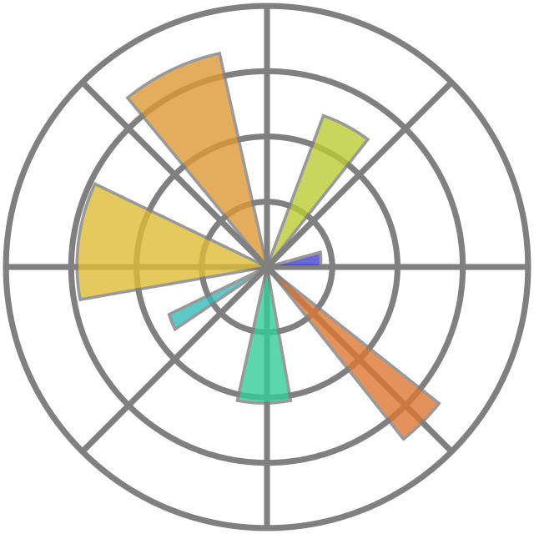

ACKNOWLEDGEMENTS
SUBMISSION
ASSISTANCE
ANALYSIS
ARTICLES
DATA
Investopedia
Federal Reserve Bank of St.Louis

Slide 17
AUTHOR
SHREYAS BANGERA Engineer
Do you have any questions?
shreyasdb99@gmail.com
+91 789 279 8834

Slide 18
THANKS

